Slide 1
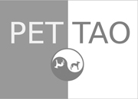
EMBRACE ANCIENT WISDOM,
ACKNOWLEDGE MODERN SCIENCE.

Slide 2


PET | TAO products are different from other products because the formulas combine the principles of Eastern Food Therapy and Western nutritional science.

Slide 3

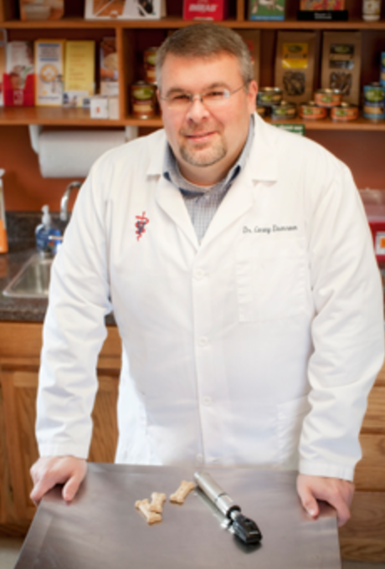
PET | TAO products were formulated and created by two veterinarians,
Dr. Marc Smith and Dr. Casey Damron,
who practice holistic and traditional Western medicine.

Slide 4
The holistic component of their practices include Traditional Chinese Veterinary Medicine (TCVM).
TCVM encompasses acupuncture, herbal treatments, Tui-na, and Eastern Food Therapy.
The doctors’ knowledge of Eastern Food Therapy helped them create
PET | TAO, the most convenient form of food therapy available.

Slide 5

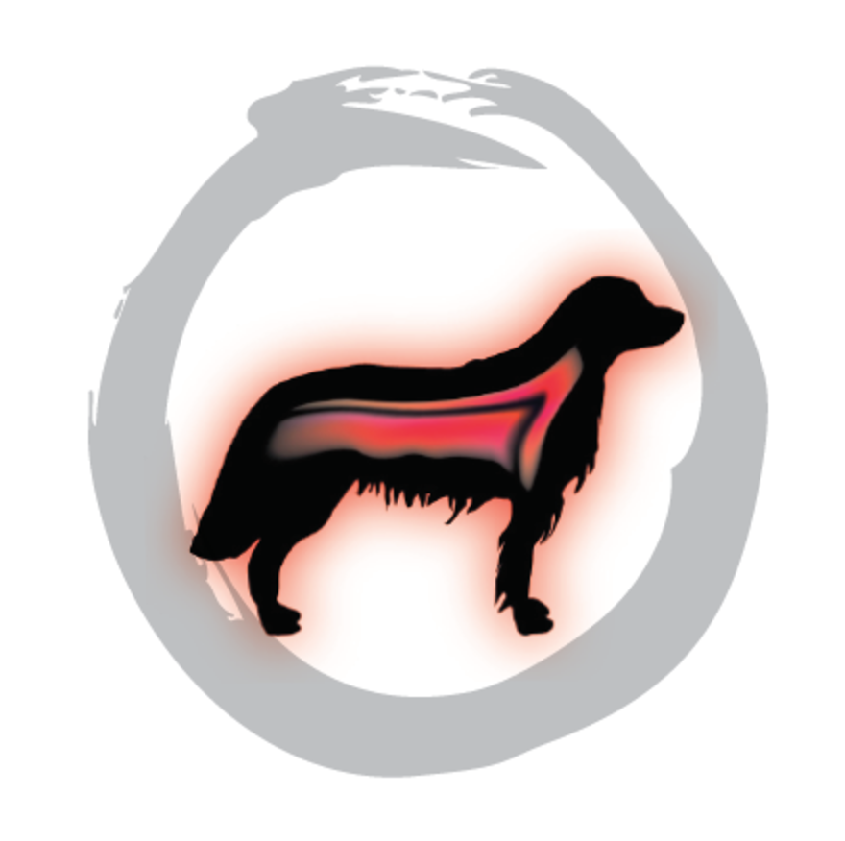

Eastern Food Therapy reflects the Yin-Yang Theory and the Five Element Theory.
The Yin-Yang Theory breaks down elements into warming and cooling.
The warming aspect is Yang, the cooling is Yin.

Slide 6
Foods create different energetic effects once they’re ingested.
For example, eating a cucumber or banana is energetically cooling.
Eating a habanero pepper is energetically warming.

Slide 7
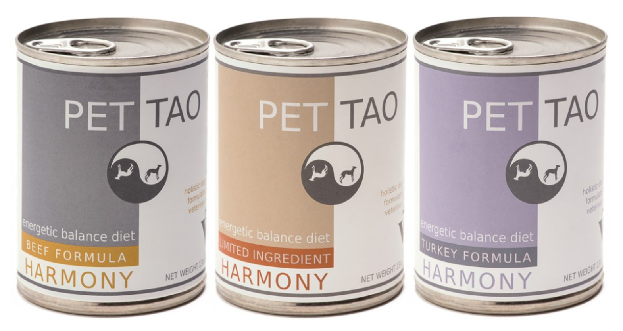
PET | TAO Canine Harmony formulas are energetically neutral.
Being neutral, the Harmony formulas maintain energetic balance in already healthy pets.
Our Harmony line includes three formulas:
Beef, Turkey, and Limited Ingredient.

Slide 8
PET | TAO Canine Solutions line includes Blaze, Chill and Zing formulas.
The Blaze formula contains energetically warming ingredients for pets who are cold and sluggish.
The Chill formula contains energetically cooling ingredients, for pets who pant and pace.

Slide 9
Zing is our “blood building” formula.
Zing was designed for dogs needing more energy and moisture in the body, such as those with dry, flaky skin or cracked paw pads.
PET | TAO’s Feline line includes an energetically cooling Turkey formula and an energetically warming Chicken formula.

Slide 10
Our treats are based on the Five-Element Theory and the theory of “Like Treats Like.”
We used the Five-Element Theory, which corresponds to major organs of the body: Lung, Heart, Spleen, Liver and Kidney, to create our treats.
Salmon is another treat, offered as an excellent source of Omegas.

Slide 11
Eastern medicine philosophy dictates “you eat for the deficiency you have.”
For instance, you would feed Kidney treats to animals with kidney problems.
Also in Eastern medicine, the kidney meridian controls bone.
A major problem with bone is arthritis.
Therefore, Kidney treats are also good for pets with arthritis.

Slide 12
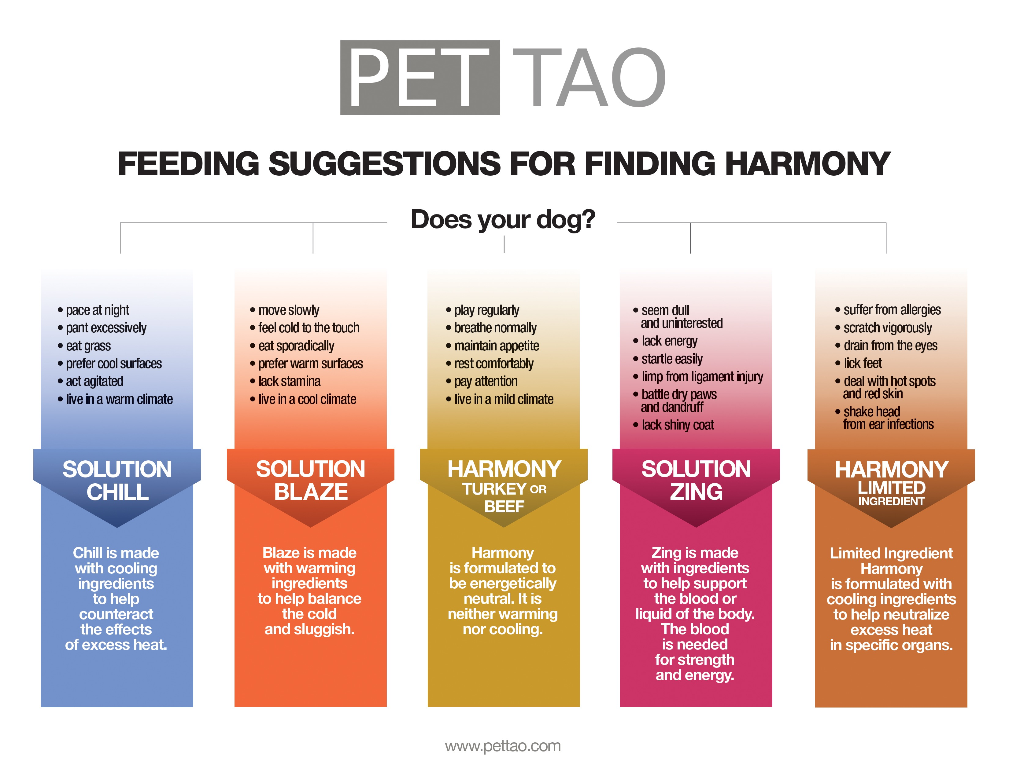
But, Eastern Food Therapy works on a much deeper level.
Accordingly, we simplified choosing food and treats with our Feeding Suggestions Chart and Treat Wheel.

